Slide 1
INDOPACOM TSIRTS
INDOPACOM Online Training (TSIRT)
Theater Specific Individual Readiness Training
as of 20250318

Slide 2
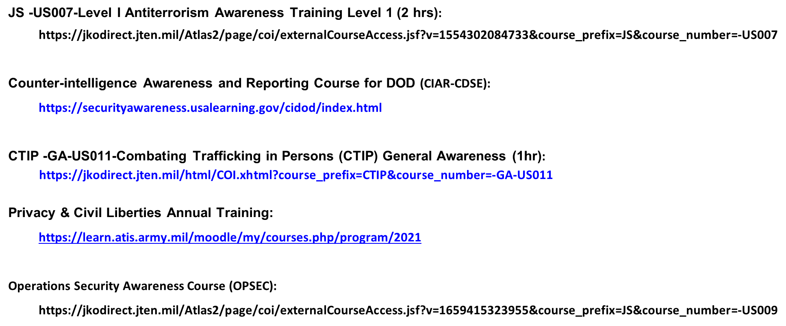

Slide 3
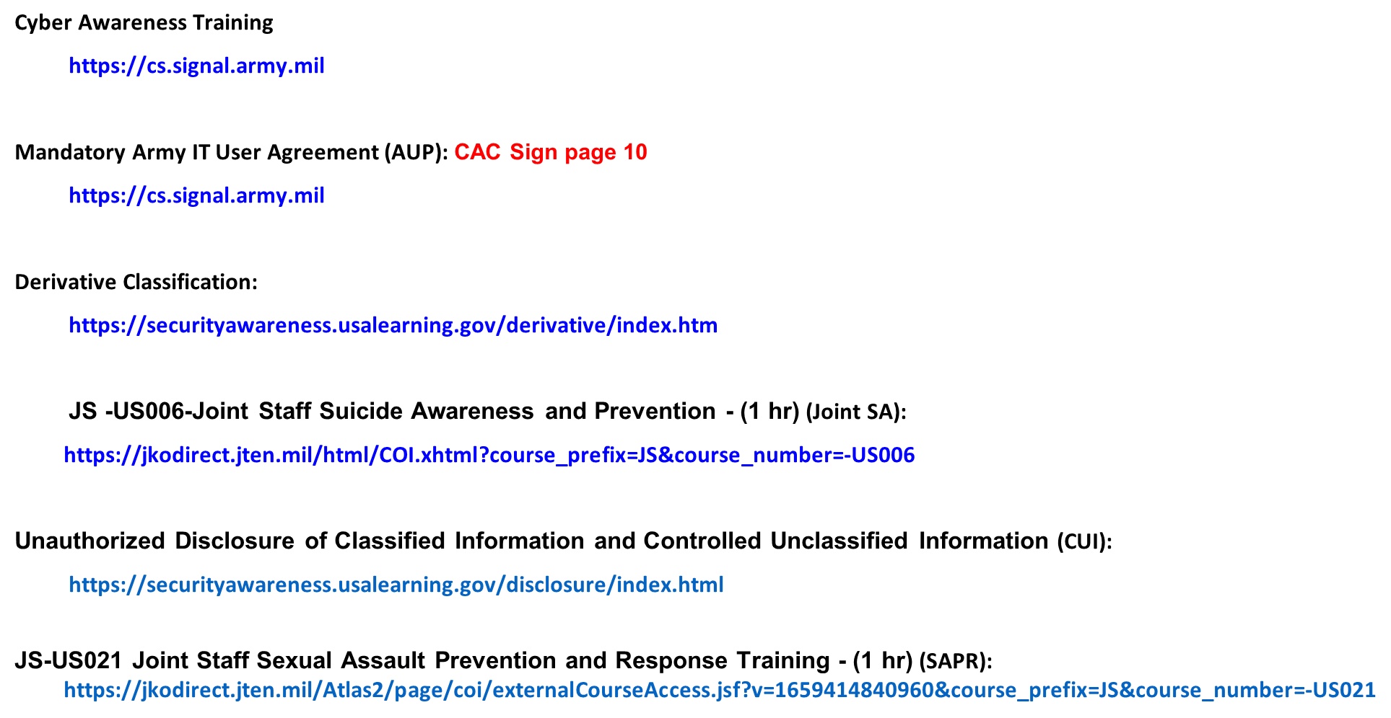

Slide 4
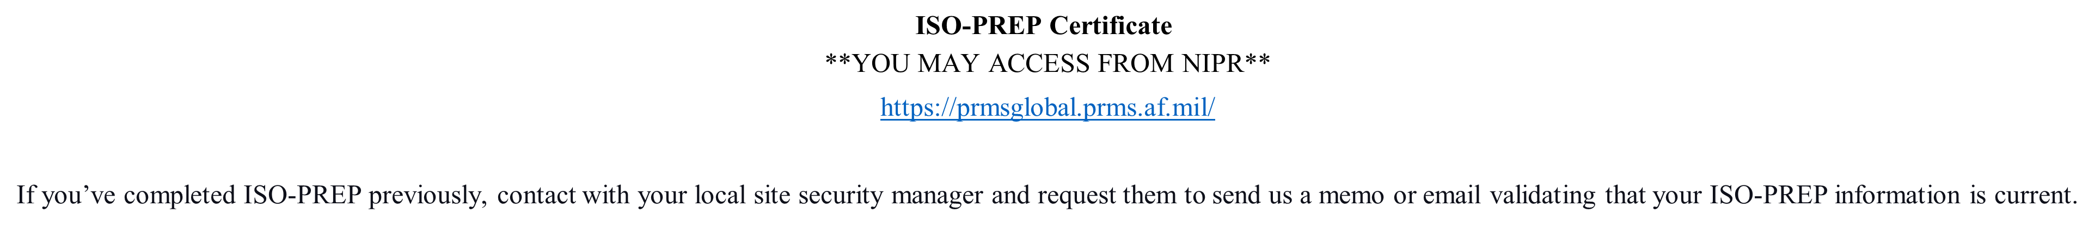
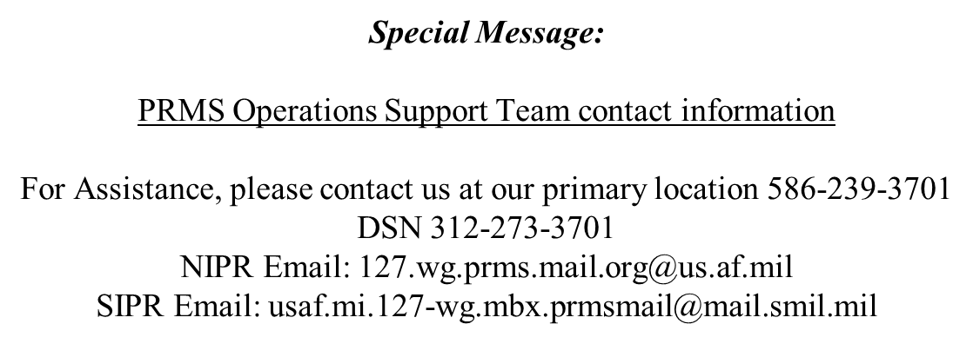

Slide 5
