Slide 1
CENTCOM Online Training (TSIRTS)
Training Needs Completed Prior to Reporting to Camp Atterbury
Insider Threat Awareness (TARP):
  https://securityawareness.usalearning.gov/itawareness/index.htm
Anti-Terrorism Awareness (Level1):
  https://jkodirect.jten.mil/Atlas2/page/coi/externalCourseAccess.jsf?v=1554302084733&course_prefix=JS&course_number=-US007
Emergency Preparedness Response Course:
  jkodirect.jten.mil/html/COI.xhtml?course_prefix=DMRTI&course_number=-US026
Joint Staff Suicide Awareness and Prevention:
  https://jkodirect.jten.mil/html/COI.xhtml?course_prefix=JS&course_number=-US006
Combating Trafficking in Persons: (General Awareness A)
  https://jkodirect.jten.mil/html/COI.xhtml?course_prefix=CTIP&course_number=-GA-US011
SERE 100.2 (Code of Conduct):
  https://jkodirect.jten.mil/Atlas2/page/coi/externalCourseAccess.jsf?v=1554302308095&course_prefix=J3T&course_number=A-US1329
Cyber Awareness and Mandatory Army IT User Agreement:
  https://cs.signal.army.mil/
Operational Security (OPSEC):
  https://securityawareness.usalearning.gov/opsec/index.htm

Slide 2
Online Training (TSIRTS)
Training Needs Completed Prior to Reporting to Camp Atterbury
Derivative Classification:
  https://securityawareness.usalearning.gov/derivative/index.htm
Intro to Biometrics:
  https://www.tam.usace.army.mil/portals/53/docs/udc/training/biometrics%20101.pdf
Discharge of Classified Information:
  https://securityawareness.usalearning.gov/disclosure/index.html

Slide 3
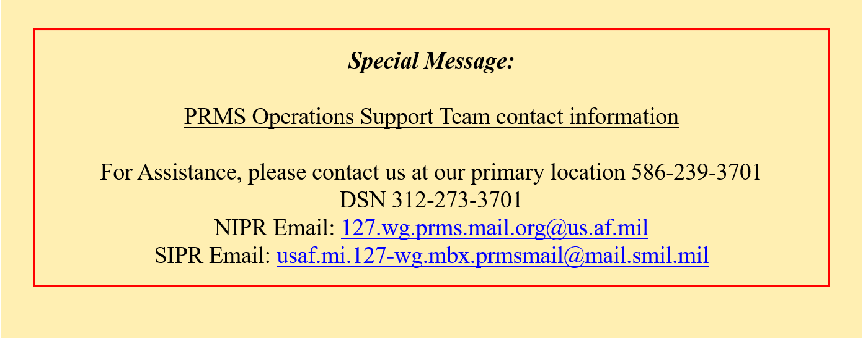
  ISO-PREP Certificate
**YOU MAY ACCESS FROM NIPR**
https://prmsglobal.prms.af.mil/
If you’ve completed ISO-PREP previously, contact with your local site security manager and request them to send us a memo or email validating that your ISO-PREP information is current.

Slide 4
Online Training (TSIRTS)
Once completed, send your TSIRT Packet to the address below:
DLL-CETAD-DART_Admin@usace.army.mil
  Please put in Subject line Last, First followed by TSIRTS: Example SMITH, JOE TSIRTS
  We can only accept PDF files
Any issues or questions with online training contact:
DLL-CETAD-DART_Admin@usace.army.mil

